Slide 1









Can we do better? Exploring MO State Electric Power Sector

Slide 2
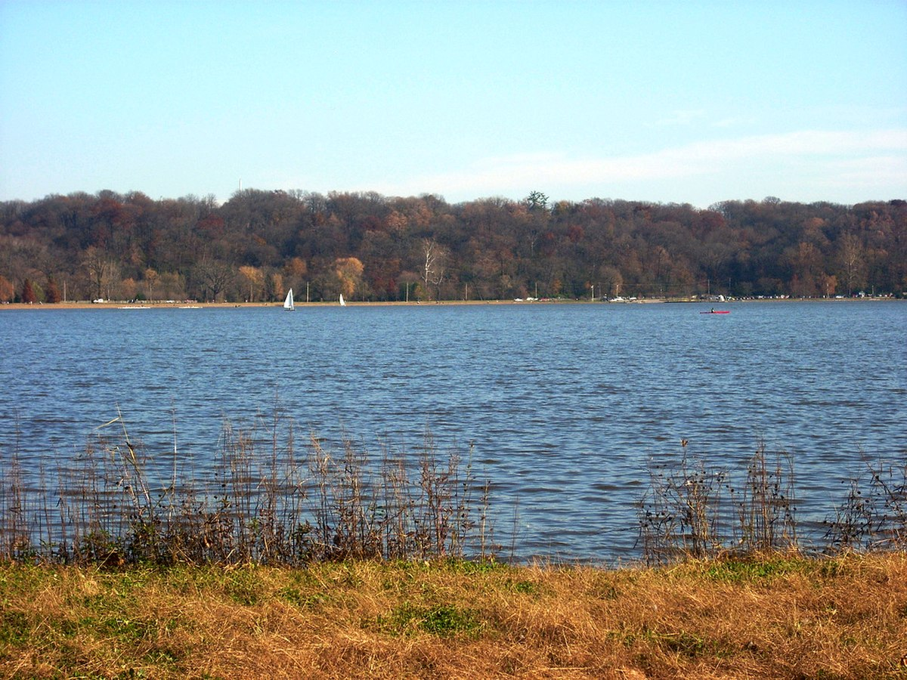

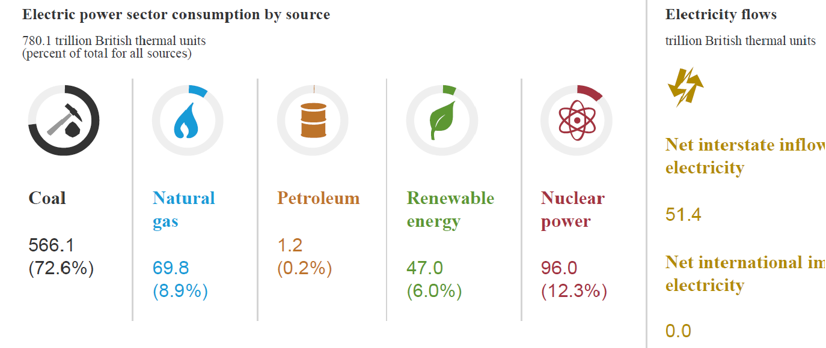
Project Name (Can we do better? Exploring MO State Electric Power Sector)
Marc Boumedine (University of the Virgin Islands)
mboumed@uvi.edu, 340 693 1255
Describe how the State of Missouri situated compared to similar states
in relation to the Electric power sector consumption by source
Balancing load, Cost saving?
Increasing the usage of
Green energy?
Visualization, ML
Python, R
Creve Coeur
Source: US Energy Information Administration
https://www.eia.gov/opendata/widgets.php

